Slide 1

Healthcare Income & Spending Chart Analytics
By Charles Orji

Slide 2
Executive Summary

Slide 3

Overview of Healthcare Income and Spending Chart Analysis
Income Variation by Age
Income peaks around age 50, with younger adults showing gradually increasing earnings influencing healthcare affordability.
Gender Differences in Spending
Spending behavior varies by gender, especially in healthcare, education, and utilities, reflecting distinct consumer demand areas.
Data-Driven Market Insights
Analysis emphasizes data-driven decisions for product positioning, pricing, and tailored messaging targeting key demographics.

Slide 4
Demographic Overview

Slide 5

Participant Demographics
Age Range Representation
Survey respondents span ages 20 to 60, covering early, mid, and late career adults for comprehensive insights.
Balanced Gender Distribution
Equal gender representation enables precise comparative analysis of spending patterns between males and females.
Spending Priorities by Age
Younger adults spend more on education and lifestyle, while older adults prioritize healthcare expenses.
Targeted Healthcare Strategies
Demographic insights guide tailored healthcare marketing, product design, and service delivery for each group.

Slide 6
Income Insights

Slide 7
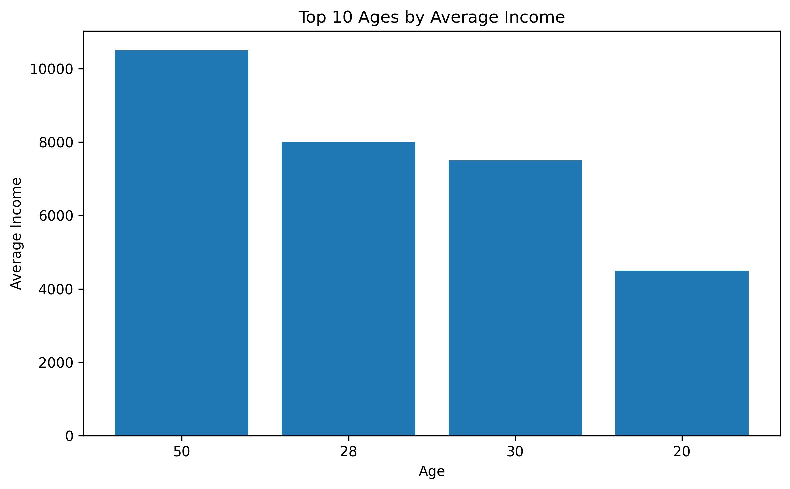
Age‑Based Income Distribution

Slide 8
Age‑Based Income Distribution
Age Group | Average Income
20 | 4500
28 | 8000
30 | 7500
50 | 10500

Slide 9

Income Distribution Insights
Income Growth After 40
Incomes tend to rise significantly after age 40 due to mid‑career progression and accumulated experience.
Younger Worker Income Volatility
Individuals in their 20s and 30s experience greater income volatility due to job mobility and lower seniority.
Income Gaps Among Youth
Wider income gaps among younger workers reflect disparities in education, job access, and industry choice.
Healthcare Product Strategy
Tailoring healthcare products by age group is crucial, with flexible options for younger and premium products for older groups.

Slide 10
Spending Insights

Slide 11
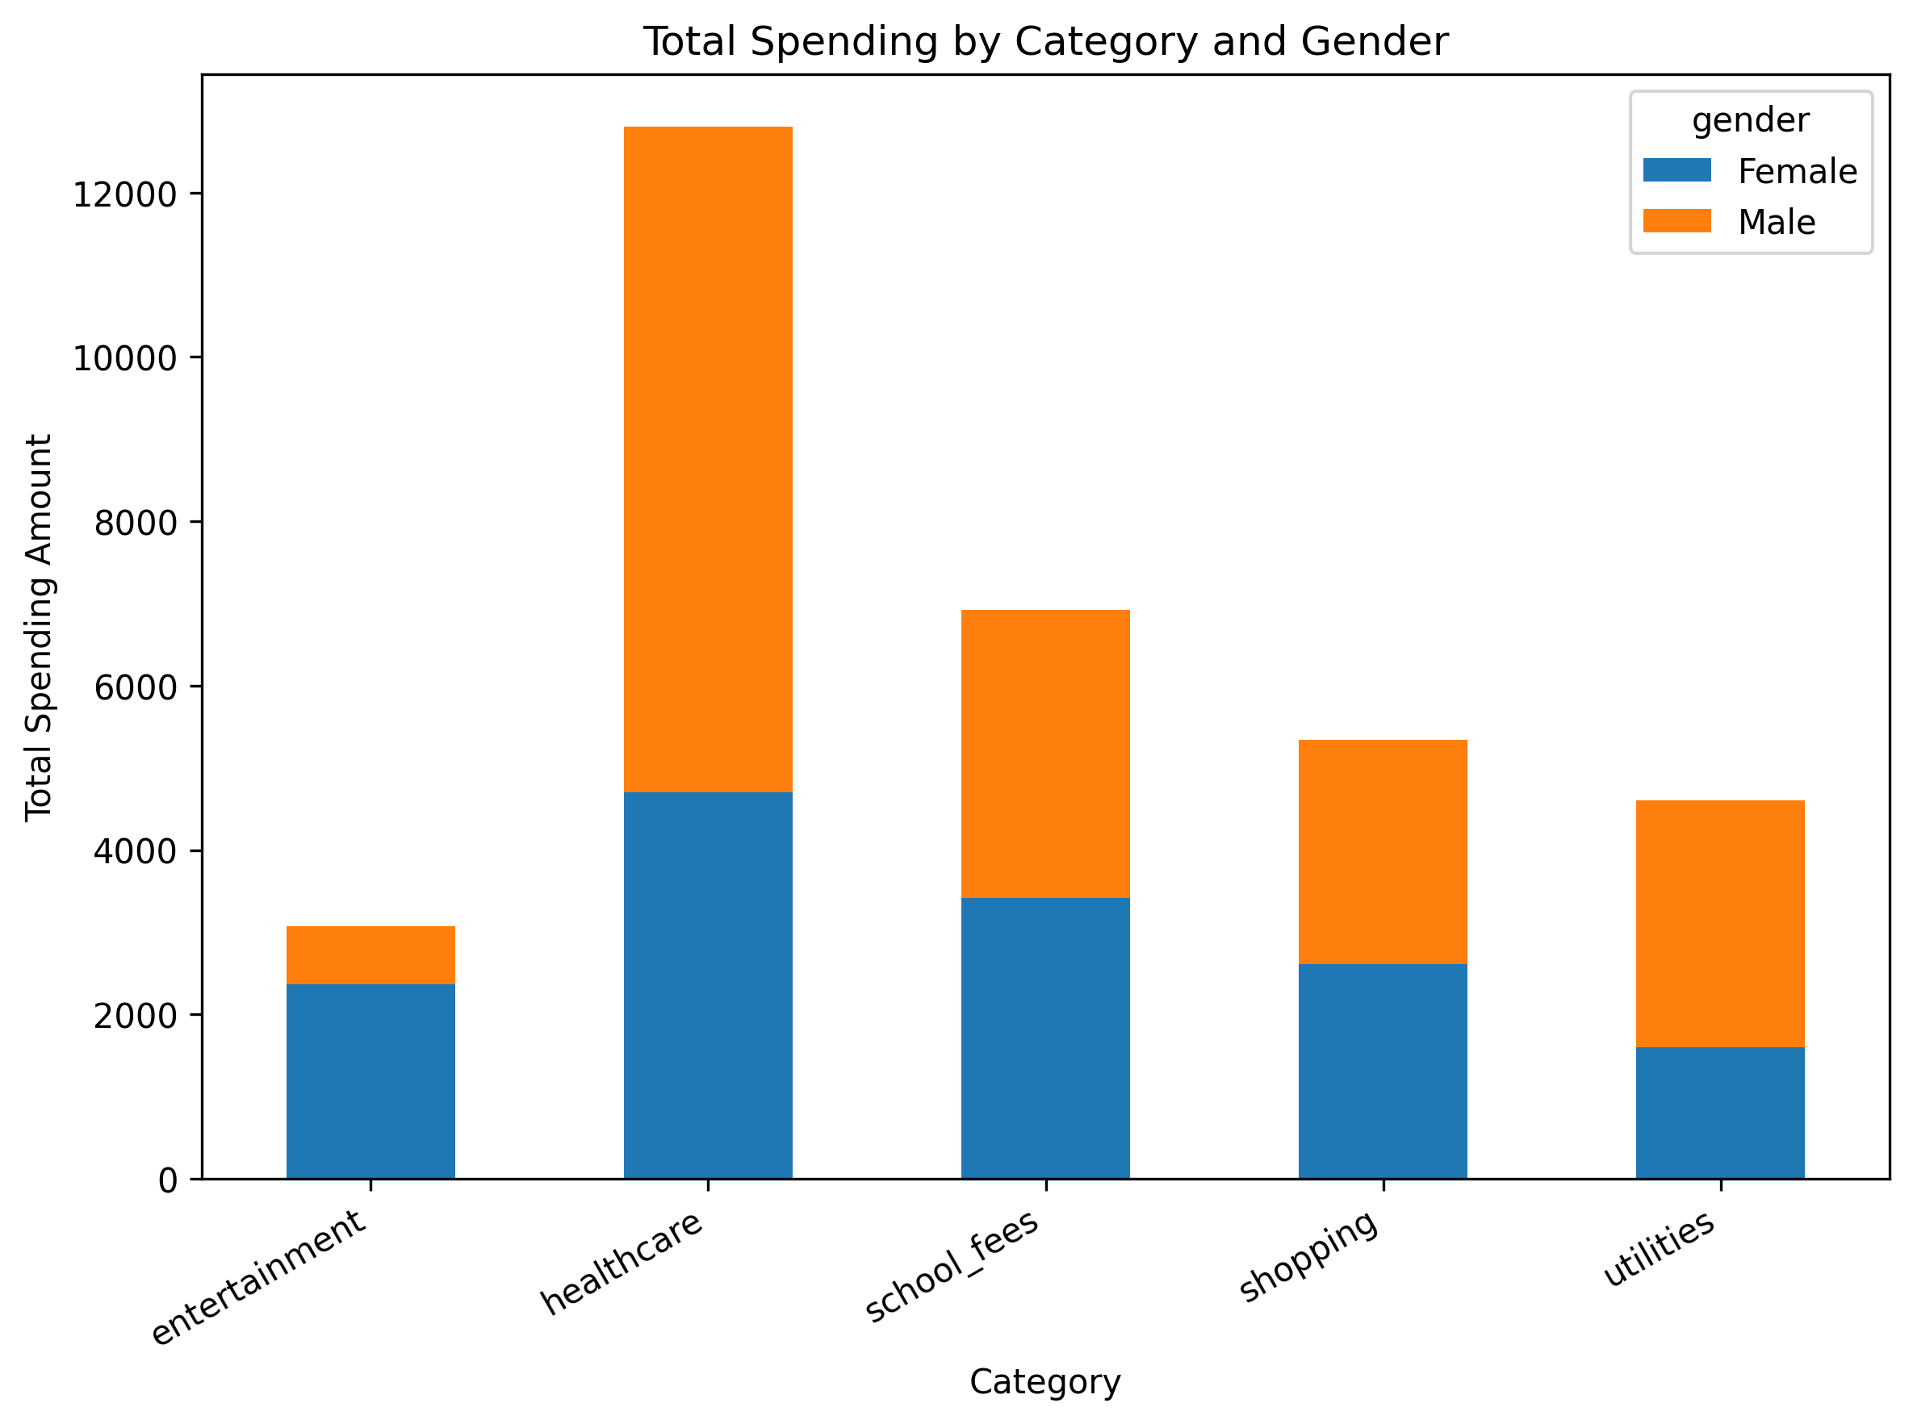
Category Spending by Gender

Slide 12
Category Spending by Gender
Category | Female Spending | Male Spending
Entertainment | 2400 | 600
Healthcare | 4700 | 8200
School Fees | 3400 | 3500
Shopping | 2600 | 2800
Utilities | 1600 | 3100

Slide 13

Spending Patterns
Healthcare as Largest Expenditure
Healthcare spending is the top priority, showing strong financial engagement in health services and products.
Mid-Age Spending Trends
Mid-age groups have the highest spending levels, reflecting greater income and financial capacity in middle adulthood.
Gender-Specific Wellness Spending
Women show higher interest and spending in wellness and fitness, indicating targeted marketing opportunities.

Slide 14
Market Readiness Analysis

Slide 15

Healthcare Product Adoption Potential
Market Readiness and Spending
Healthcare market shows strong readiness, supported by recurring expenditures and stable incomes in key demographics.
Demographic Spending Insights
Male and middle-aged groups exhibit higher spending and capacity, indicating strong adoption potential for healthcare products.
Younger Consumer Interest
Younger consumers prefer affordable, preventive health services, highlighting importance of tiered pricing and diversification.
Strategic Product Alignment
Aligning product offerings with demographic spending and income boosts market capture and adoption success.

Slide 16
Conclusion and Strategic Recommendations

Slide 17
Key Takeaways and Next Steps
Income and Purchasing Power
Income disparities show mid-career and late-career consumers have the highest readiness to purchase healthcare products.
Spending Behavior Insights
High healthcare spending indicates significant market potential, guiding targeted marketing and pricing strategies.
Strategic Marketing Recommendations
Focus on targeted marketing, gender-specific messaging, and flexible pricing to align with consumer preferences.
Preventive Healthcare Investment
Investing in preventive healthcare awareness can expand demand among younger and emerging consumer segments.

